Slide 1


Slide 2
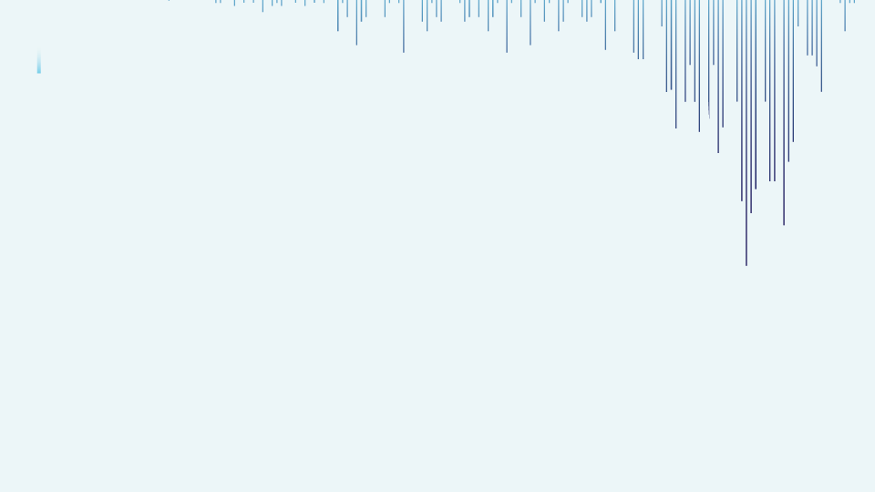


Brain Stroke Prediction
Presented By:- Sayed Mohammed Faisal

Slide 3
Information
The aim of my project is to build a Model that can be used to predict whether a patient is going to get stroke based on the parameters.
With this model, Hospitals and other Healthcare centres can analyze the patient past history, get to know if they have a chance of stroke and most importantly this will help them to treat them accordingly without major risks of strokes.

Slide 4
Project Contents
Importing Libraries & Data Loading
EDA (Exploratory Data Analysis) & Preprocessing
Train & Test Split
Model Building
Decision Tree
Logistic Regression
Conclusion

Slide 5
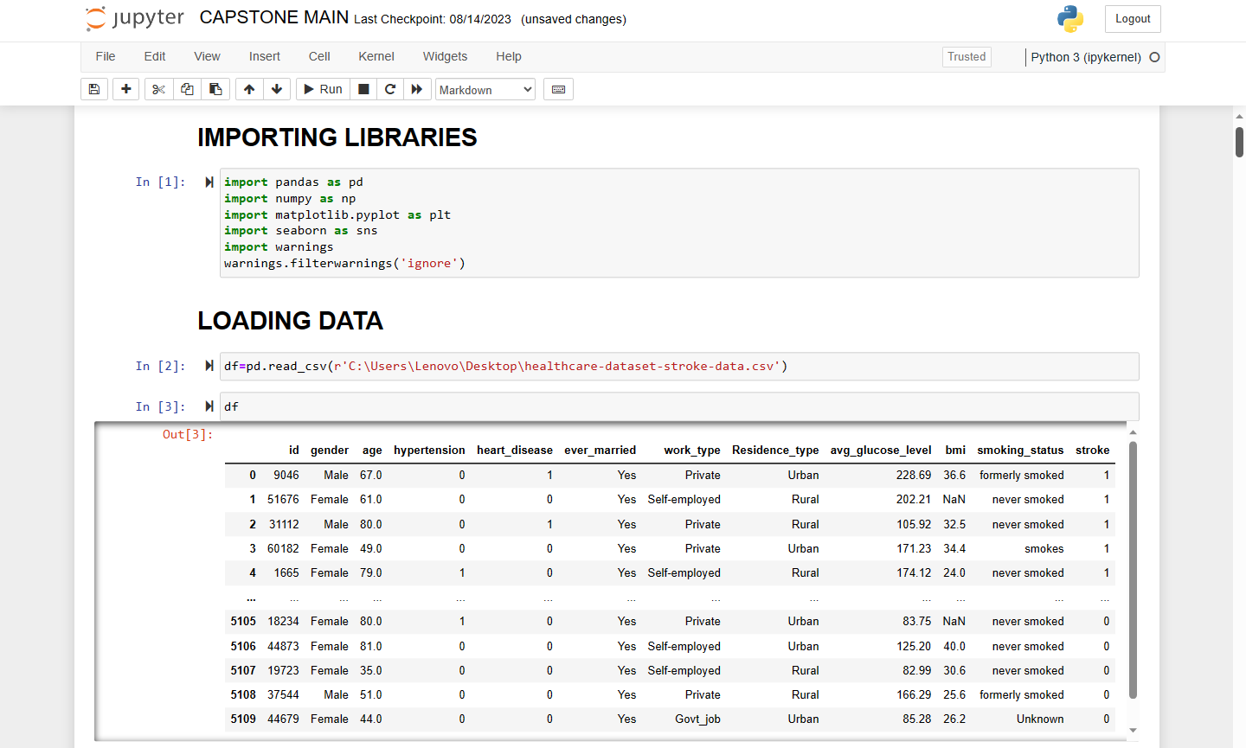
Importing Libraries & Data Loading
Libraries:-
Pandas (pd)
Numpy (np)
Matplotlib.pyplot (plt)
Seaborn (sns)
Loading the data using pd.read_csv

Slide 6
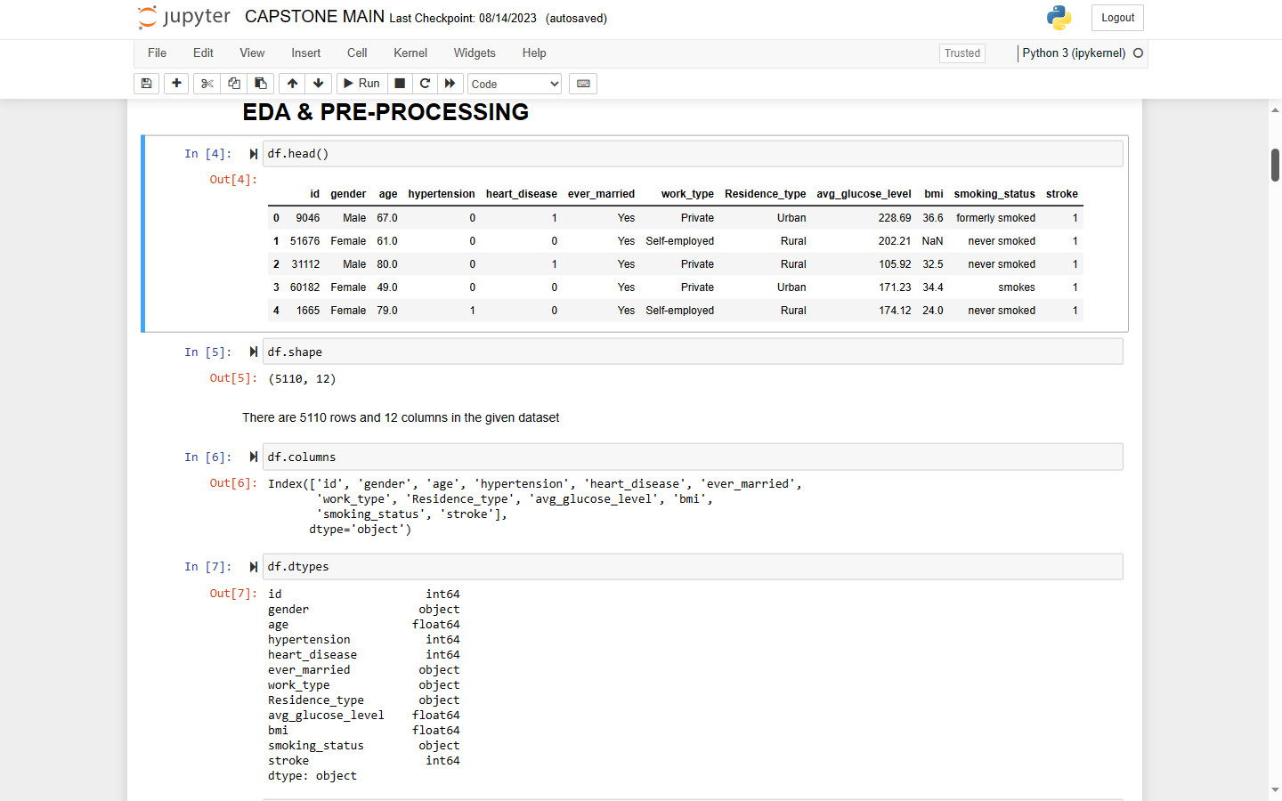
EDA (Exploratory Data Analysis) & Preprocessing
Highlights:
Checking number of rows and columns (shape).
Checking for column names.
Checking the data types.

Slide 7
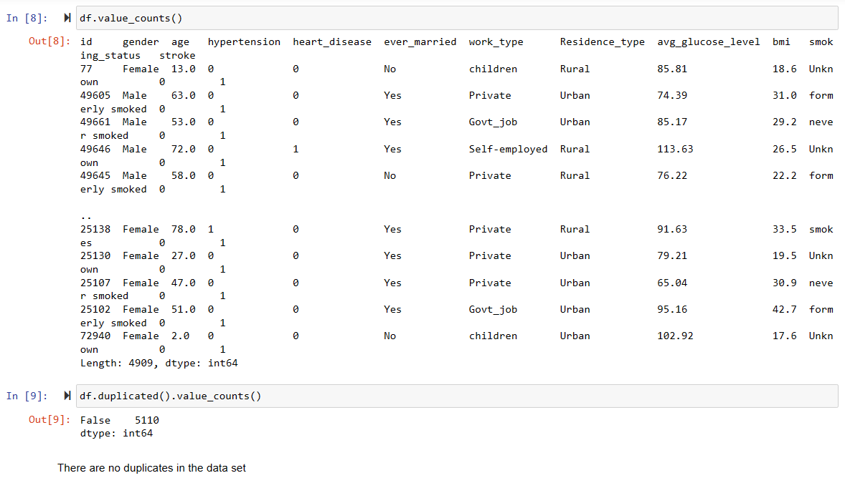
Highlights:
4. Checking for value counts.
5. Checking for duplicates in the data.

Slide 8
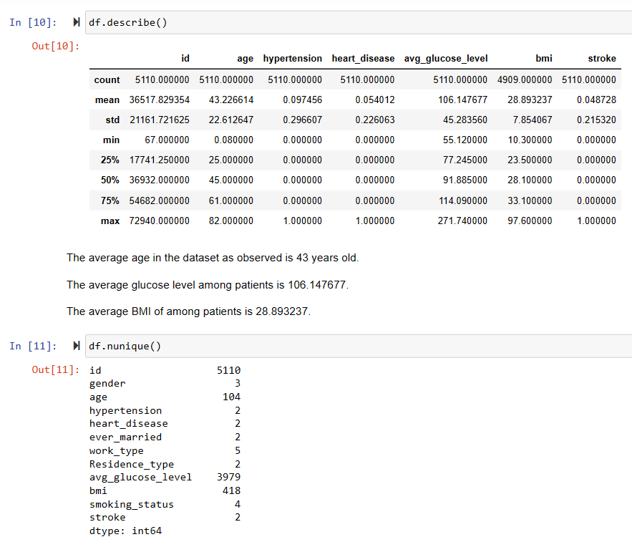
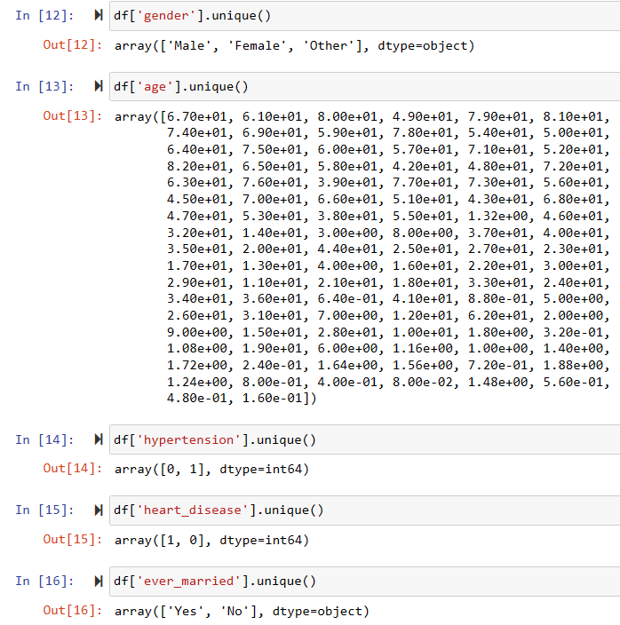
Highlights:
6. Descriptive analysis of the dataframe.
7. Checking for unique values.
8. Checking for unique values of each column of the dataset.

Slide 9
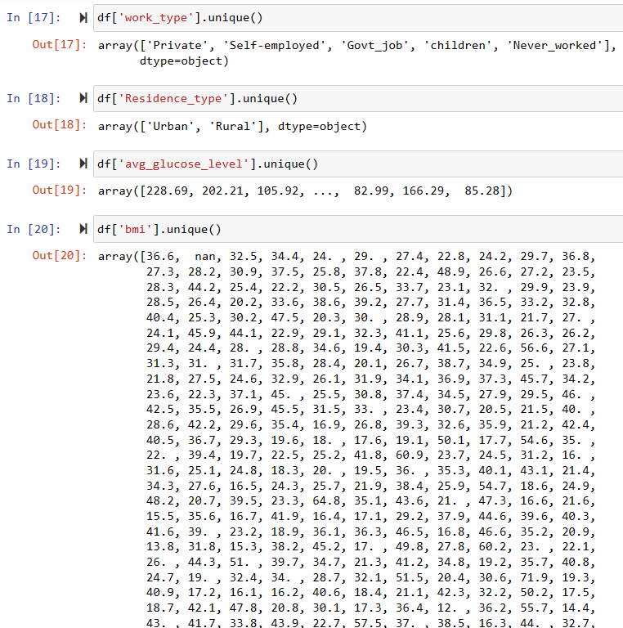
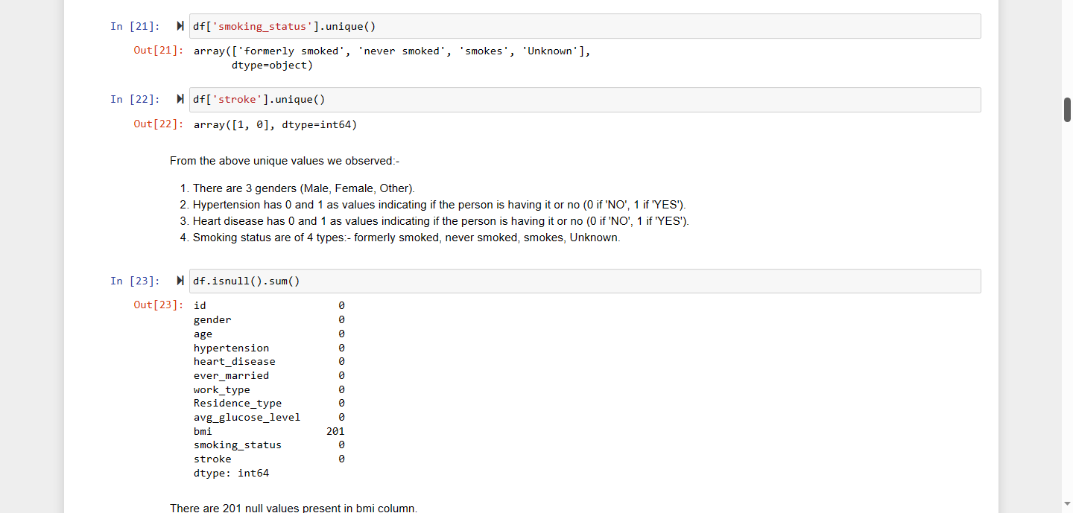

Slide 10
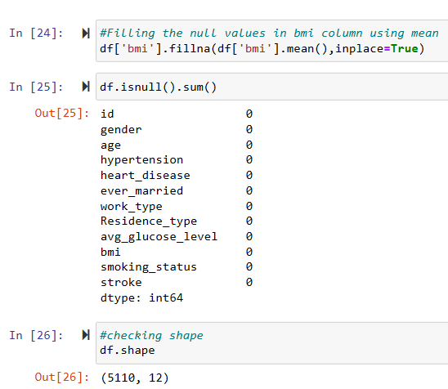
Highlights: 9. Checking for null values in the dataset.
10. Filling the null values using mean.
11. Checking shape.

Slide 11
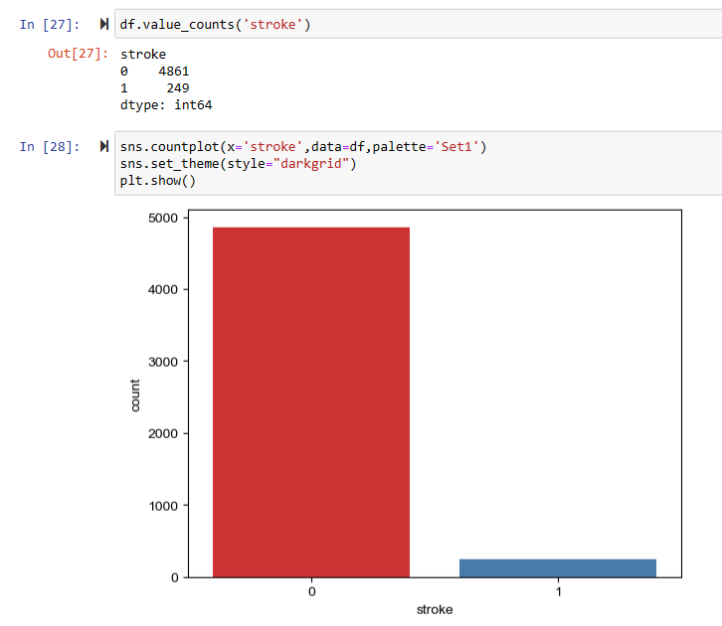
Visualization – Count plot
Highlights: 12. Checking value counts of stroke.
13. Plotting count plot of stroke.
14. Plotting Distribution plots of stroke by BMI and as per age.

Slide 12
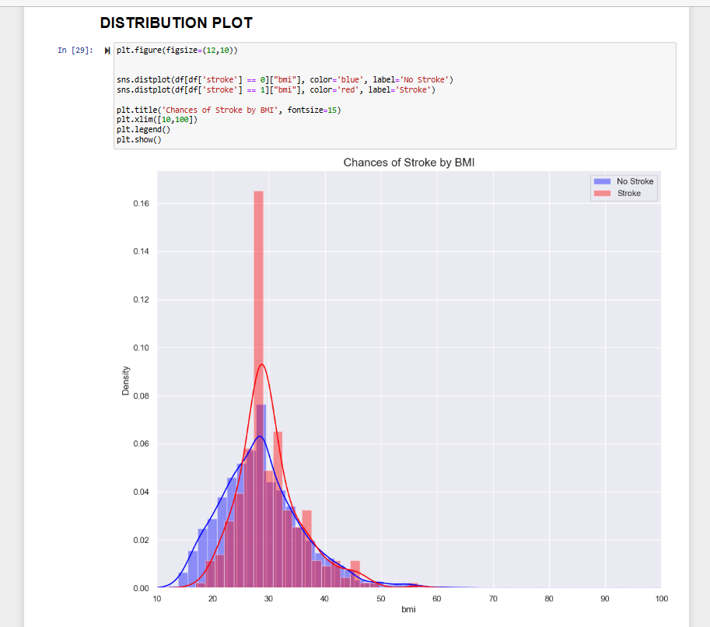
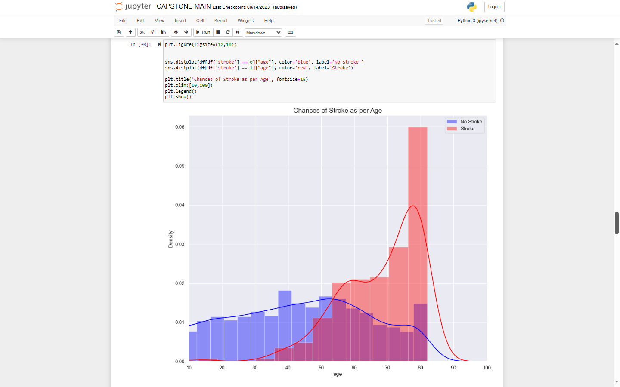
Visualization – Distribution plot

Slide 13
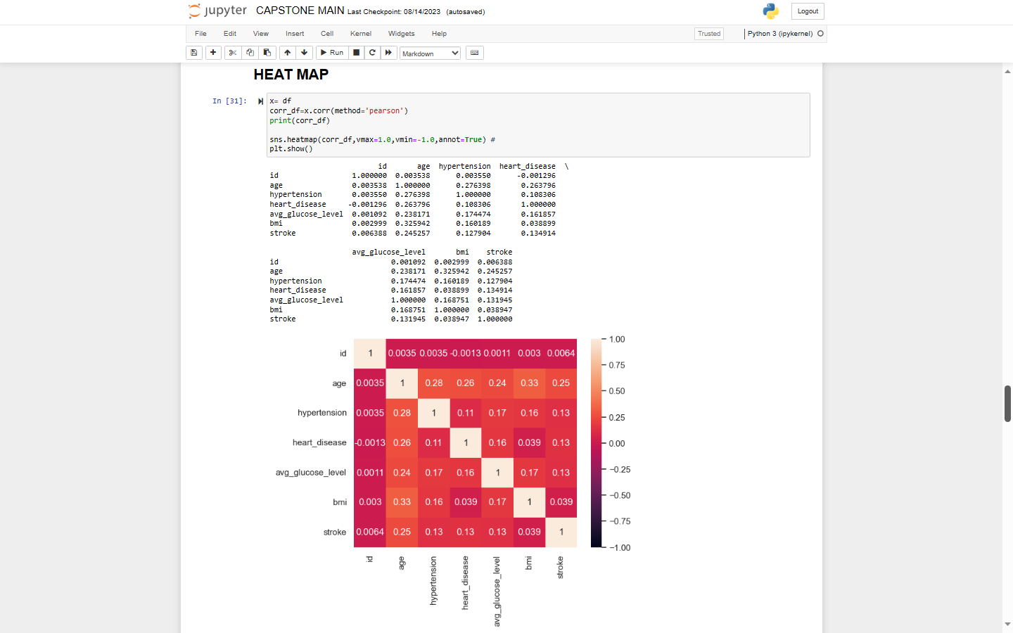
Visualization – Heat Map
Highlights: 15. Plotting heat map for correlation of the given parameters.

Slide 14
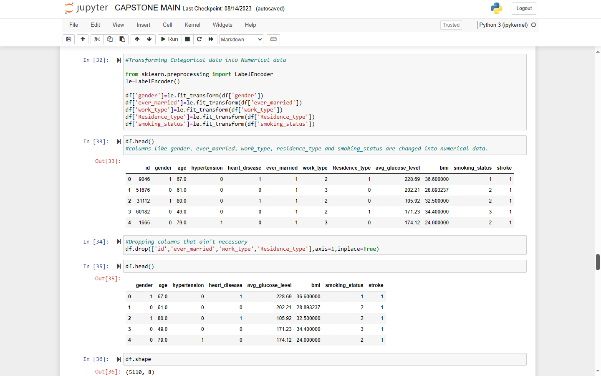
Highlights: 16. Transforming categorical data into numerical data using LabelEncoder.
17. Dropping columns that are not required using drop function.

Slide 15
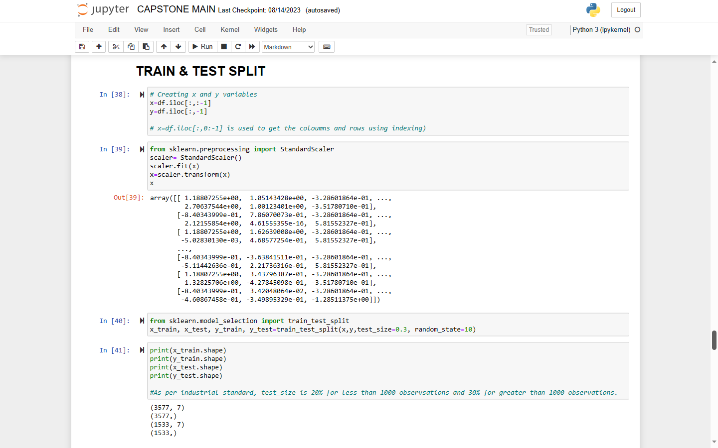
Train & Test Split
Highlights: 18. Creating x and y variables.
19. Performing Standardization using StandartScaler.
20. Performing train test split and checking shape.
Splitting of data:-
80% of data goes for training.
20% data goes for testing,

Slide 16
Model Building
Selection of Model - As the given data is Binary Classification, therefore I chose to go with Decision Tree and Logistic Regression.

Slide 17
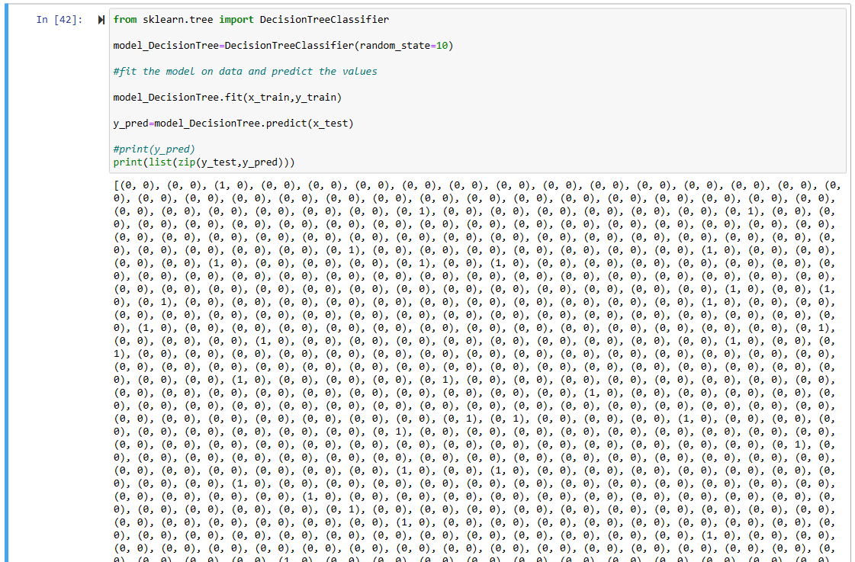
Decision Tree

Slide 18
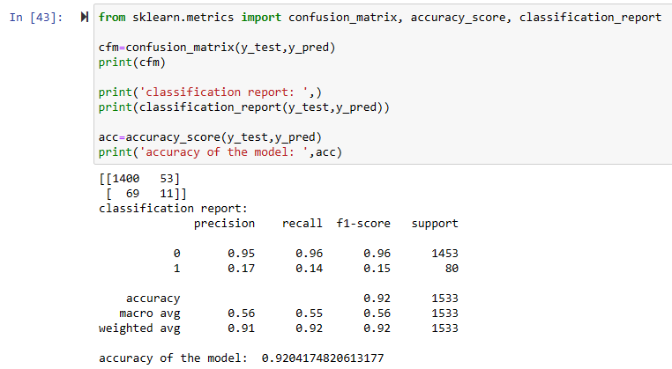
The Accuracy of the model using Decision Tree is 92%

Slide 19
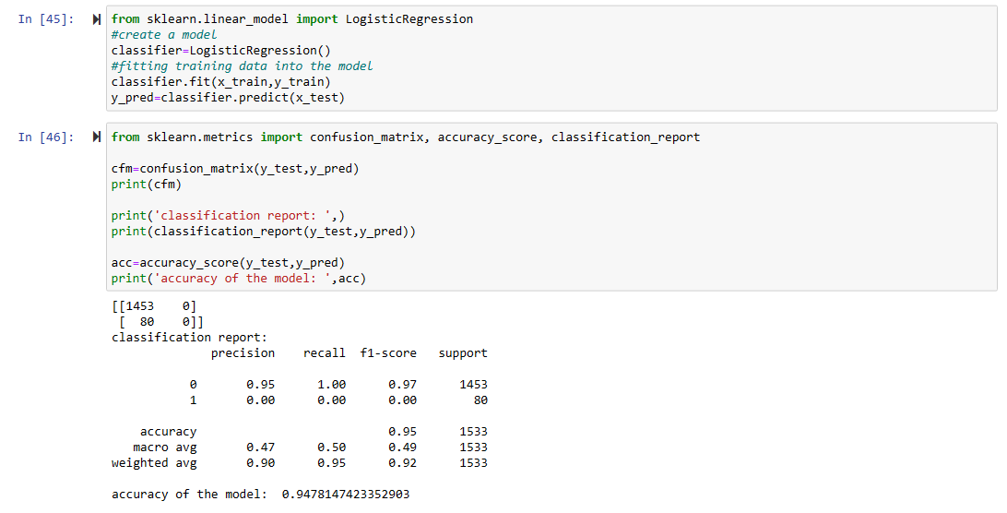
Logistic Regression
The Accuracy of the model using Decision Tree is 94.7%

Slide 20
Conclusion
Both the algorithms gives the accuracy above 90% for the given dataset of Brain stroke prediction.
The accuracy using logistic regression is 94.7% and decision tree is 92%.
Even though logistic regression gives more accuracy than decision tree, we won’t use logistic regression as it is over-fitting as the dataset is imbalance.

Slide 21

Thankyou!!!

